Slide 1
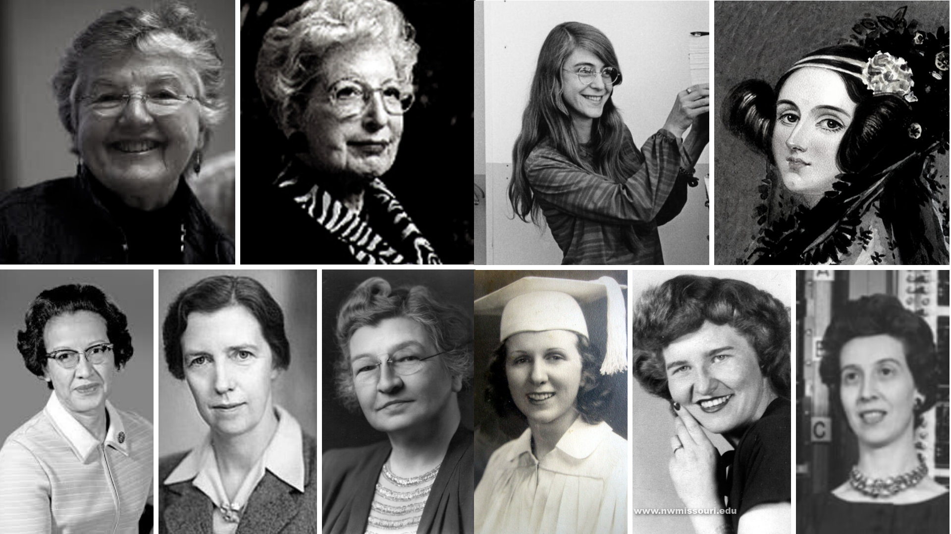

How women have influenced the field of computer science
Anhelina Belavezha, Computer Science
Notes:
1

Slide 2

Presentation plan
Key vocabulary
Introduction
Significance of women’s contributions to computer science
Main part
Ada Lovelace and her work on the Analytical Engine
Grace Hopper and the invention of the compiler
A. Margaret Hamilton's role in the Apollo 11 mission
Conclusion
Recap of Women's Impact on Computer Science
Call to action for promoting diversity and inclusion
achievements
involvement
programming
compiler
software
algorithms
code optimization
gender equality
discrimination
diversity
2

Slide 3

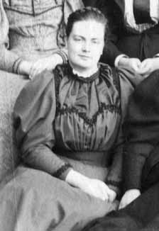
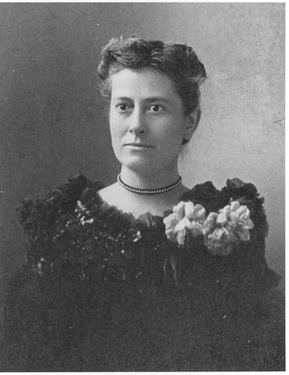
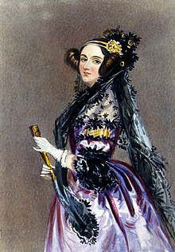
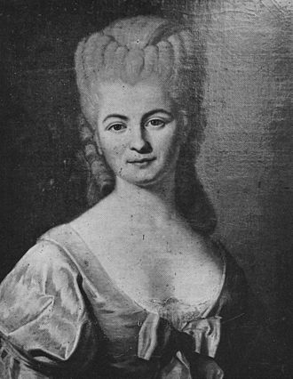

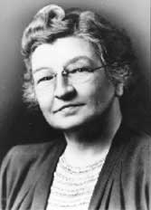
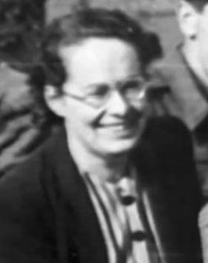
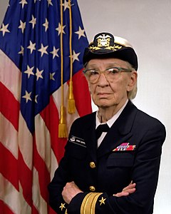
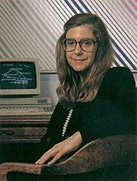

Beatrice Cave, trajectories for bomb shells
Anna Winlock, a computer for the Harvard Obs.
Ada Lovelace, first computer programmer
Nicole-Reine Lepaute, human computer
1918
1875
1840
1757
1925
1942
1943
1962
Edith Clarke, graphical calculator
Joan Clarke, cryptography
Grace Hopper, first compiler
Margaret Hamilton, NASA
3

Slide 4
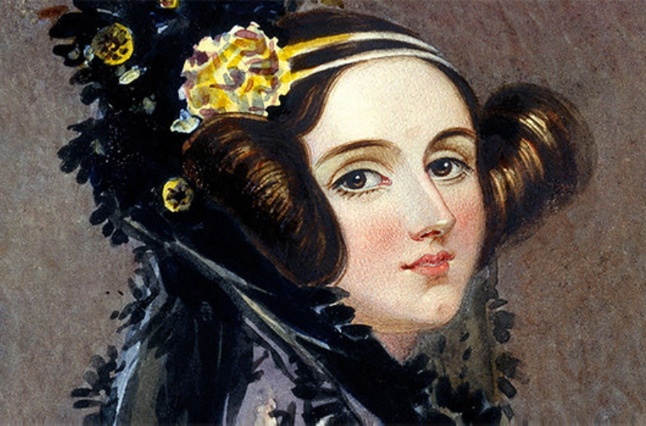
Ada Lovelace
The world’s first computer programmer
Groundbreaking work on Analytical Engine
The first computer algorithm Note G
Mathematical insights
Inspiration for women in STEM
4
Notes:
4

Slide 5
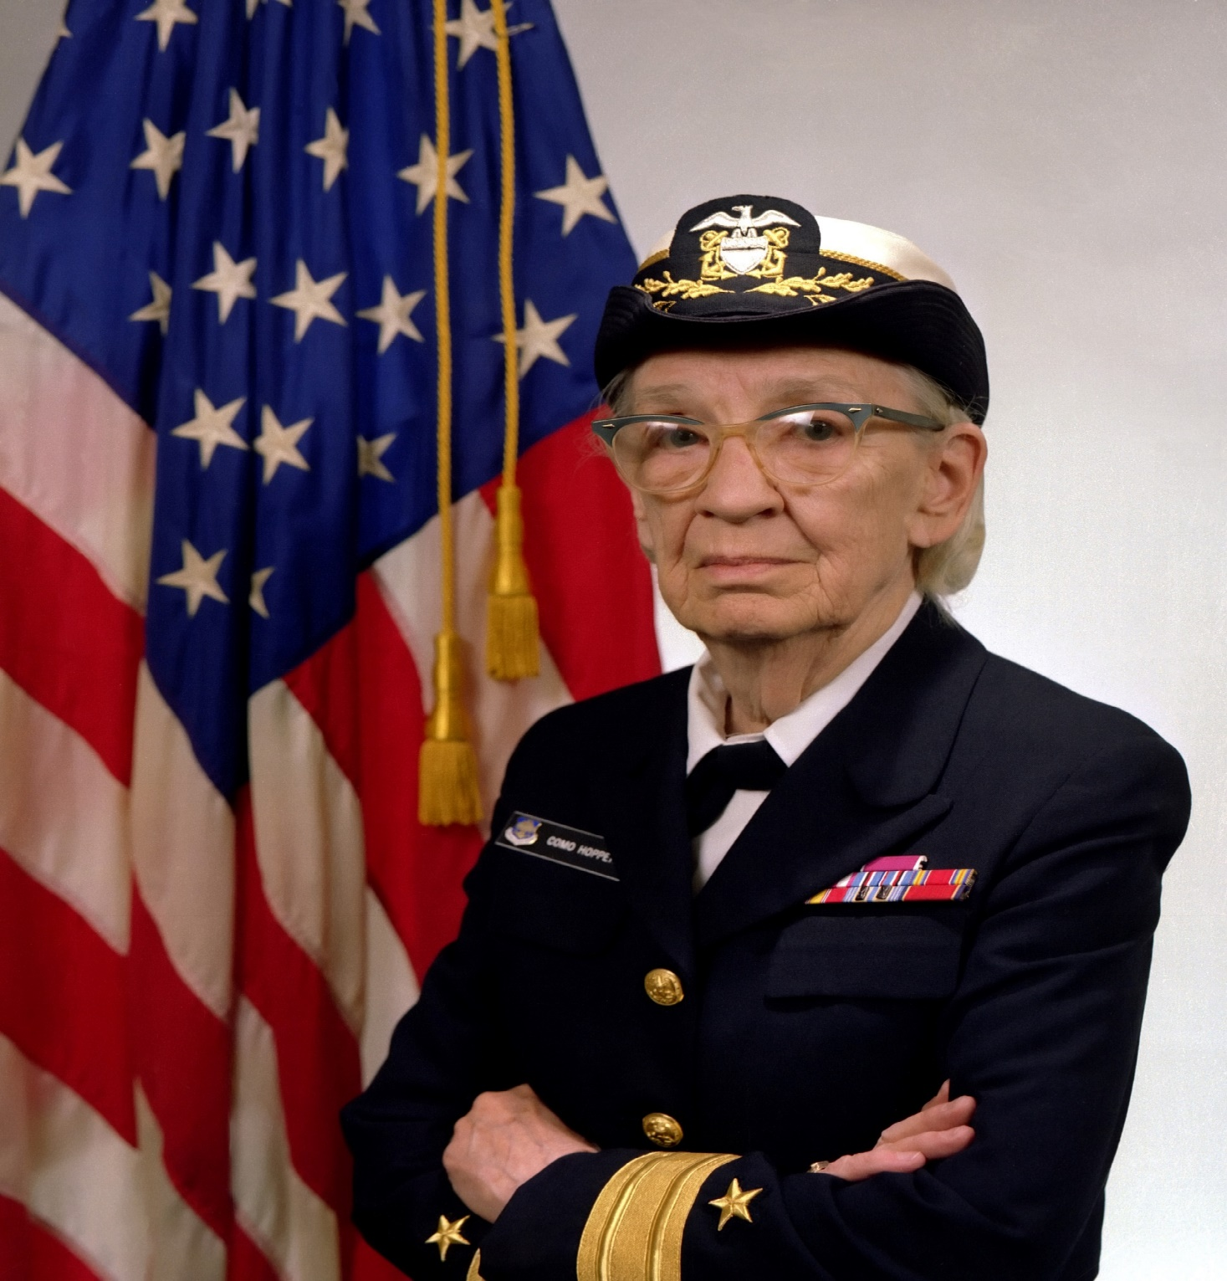
Grace Hopper
The inventor of the compiler
Invention of the compiler
COBOL programming language
Navy Rear Admiral
Advocate for women in STEM
5
Notes:
5

Slide 6
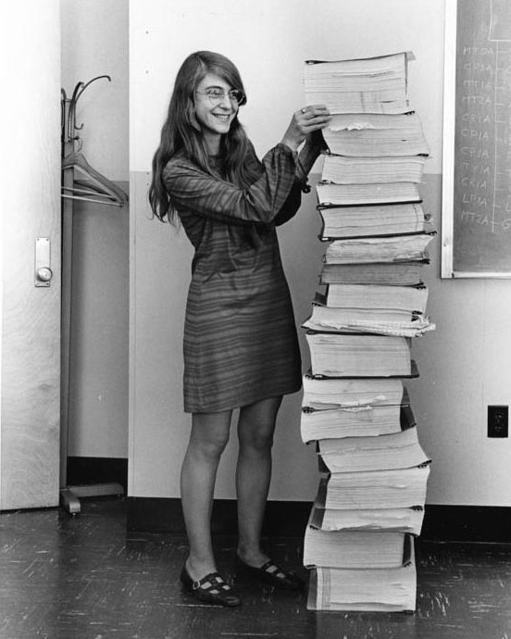
Margaret Hamilton
Takes Humans to the Moon
Apollo 11 Software engineering
Priority-based scheduling
Error detection and recovery
Term „Software engineering”
6
Notes:
6

Slide 7
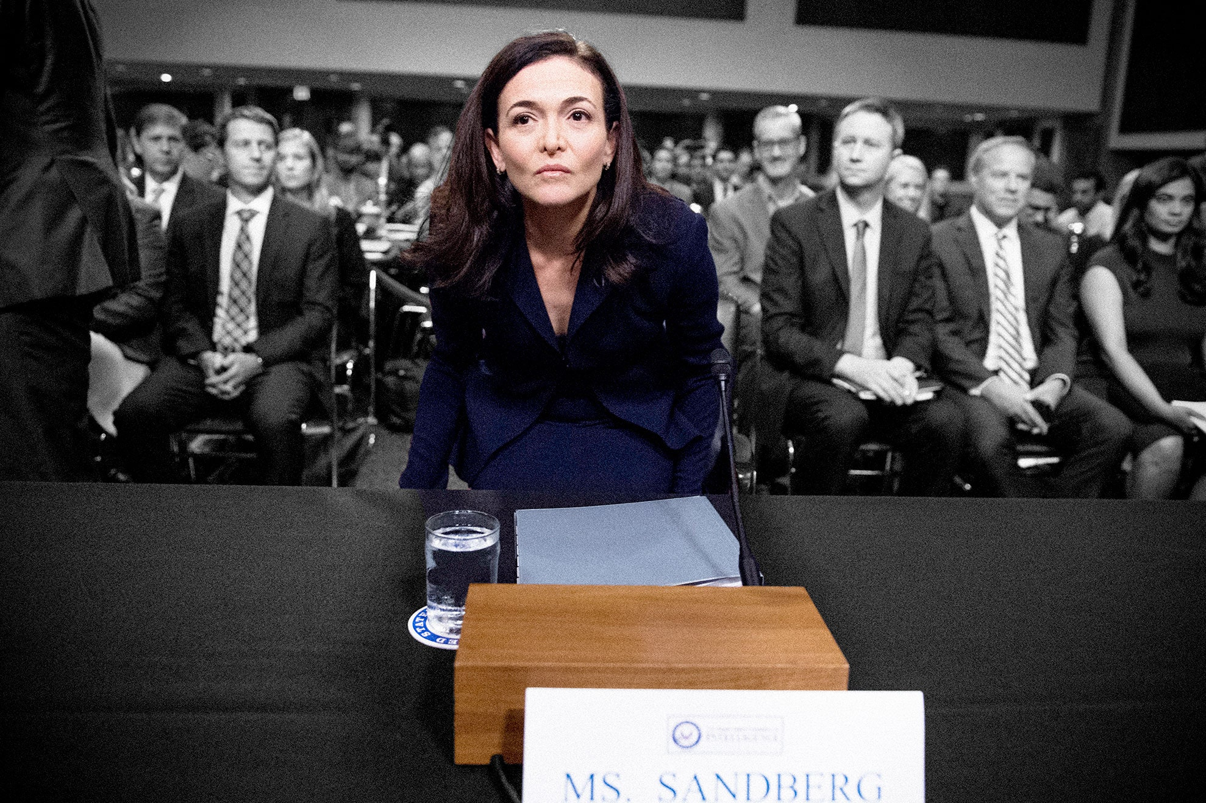
“The word ‘female,’ when inserted in front of something, is always with a note of surprise. Female COO, female pilot, female surgeon — as if the gender implies surprise … One day there won’t be female leaders. There will just be leaders.”
© Sheryl Sandberg — Facebook COO and Founder of Leanin.org
7

Slide 8
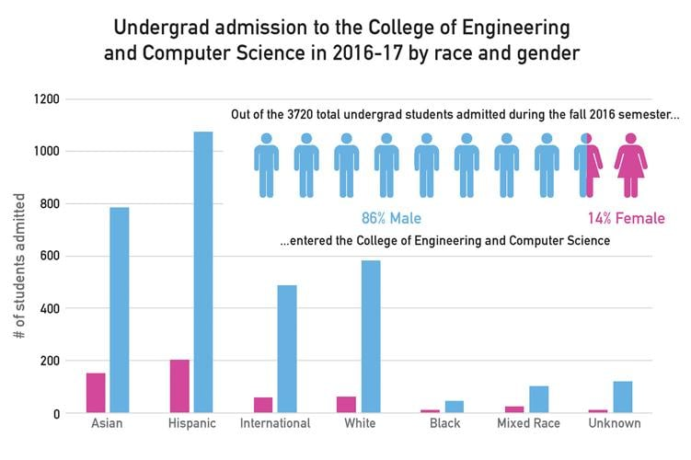
8

Slide 9

Thank you for your attention!
9
Notes:
9

Slide 10
References
1. https://www.computerscience.org/resources/most-influential-women-computer-science/
2. https://www.purdueglobal.edu/blog/information-technology/history-women-information-technology-6-female-computer-science-pioneers/#:~:text=Just%20a%20few%20of%20the,human%20space%20exploration%20(Katherine%20Johnson)
3. https://en.wikipedia.org/wiki/Women_in_computing
4. https://dailytitan.com/news/campus/prevailing-gender-gap-in-the-college-of-engineering-and-computer-science/article_e0c7f020-4dba-5fbd-a9f5-8fe080d22011.html
5. https://mathshistory.st-andrews.ac.uk/Biographies/Cave-Browne-Cave_Beatrice/pictdisplay/
6. https://whatwillittake.com/interviews/interview-sheryl-sandberg/
10

